Slide 1
Speech Emotion Recognition
Extract Human Emotions from Audio Files

Slide 2


Problem Statement
We were hired by a Call Center company for their quality assurance project, one part of this project is to analyse customer interactions, the goal is to detect emotions from the customers and agents. This will help them not only to analyse the customer behaviours but also how agents respond to customer’s emotion.
This project will serve as Proof of Concept, can we detect the 7 emotions from audio file? e.g. Angry, Disgust, Fear, Happy, Neutral, Sad, Surprised
Notes:
Studies of automatic emotion recognition systems aim to create efficient, real-time methods of detecting the emotions of mobile phone users, call center operators and customers, car drivers, pilots, and many other human-machine communication users. Adding emotions to machines has been recognized as a critical factor in making machines appear and act in a human-like manner (André et al., 2004).

Slide 3
Table of contents
01
02
Intro to Sound
Datasets
03
04
Feature Extraction
MODEL

Slide 4
What is Sound ?
Sound moves through a medium such as air or water as waves. It is measured in terms of frequency and amplitude.
Ref: https://www.nps.gov/subjects/sound/understandingsound.htm

Slide 5
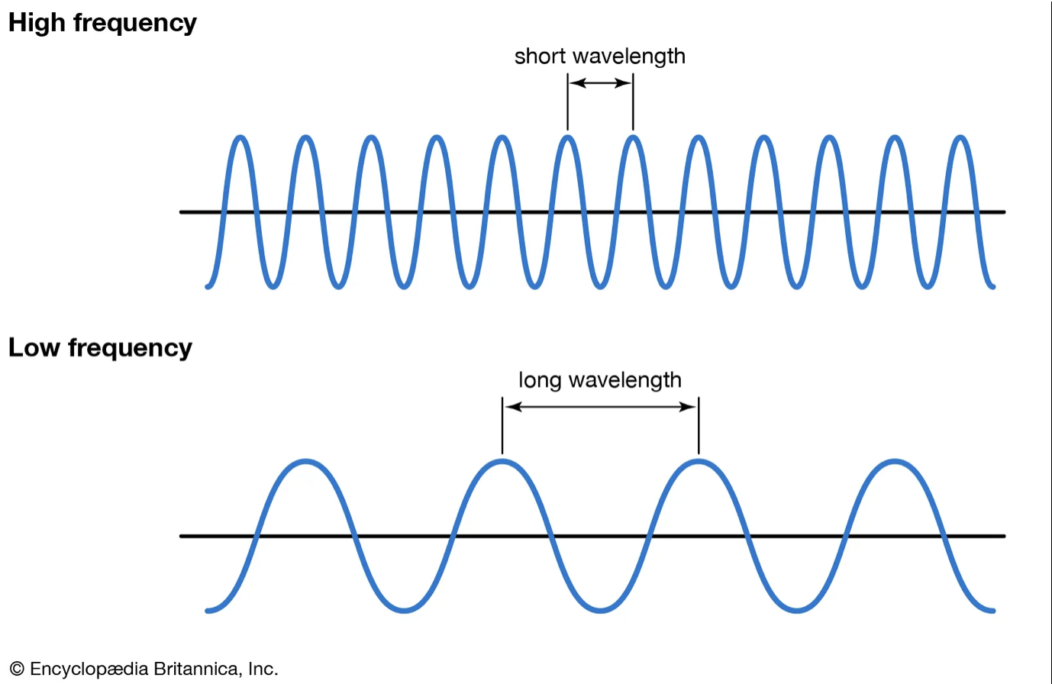
Frequency
Frequency, sometimes referred to as pitch, is the number of times per second that a sound pressure wave repeats itself.
The lower the frequency, the fewer the oscillations.
High frequencies produce more oscillations.
Notes:
(higher frequency -> higher sound)
Pitch — how high or low a sound is. It depends on frequency, higher pitch is high frequency

Slide 6

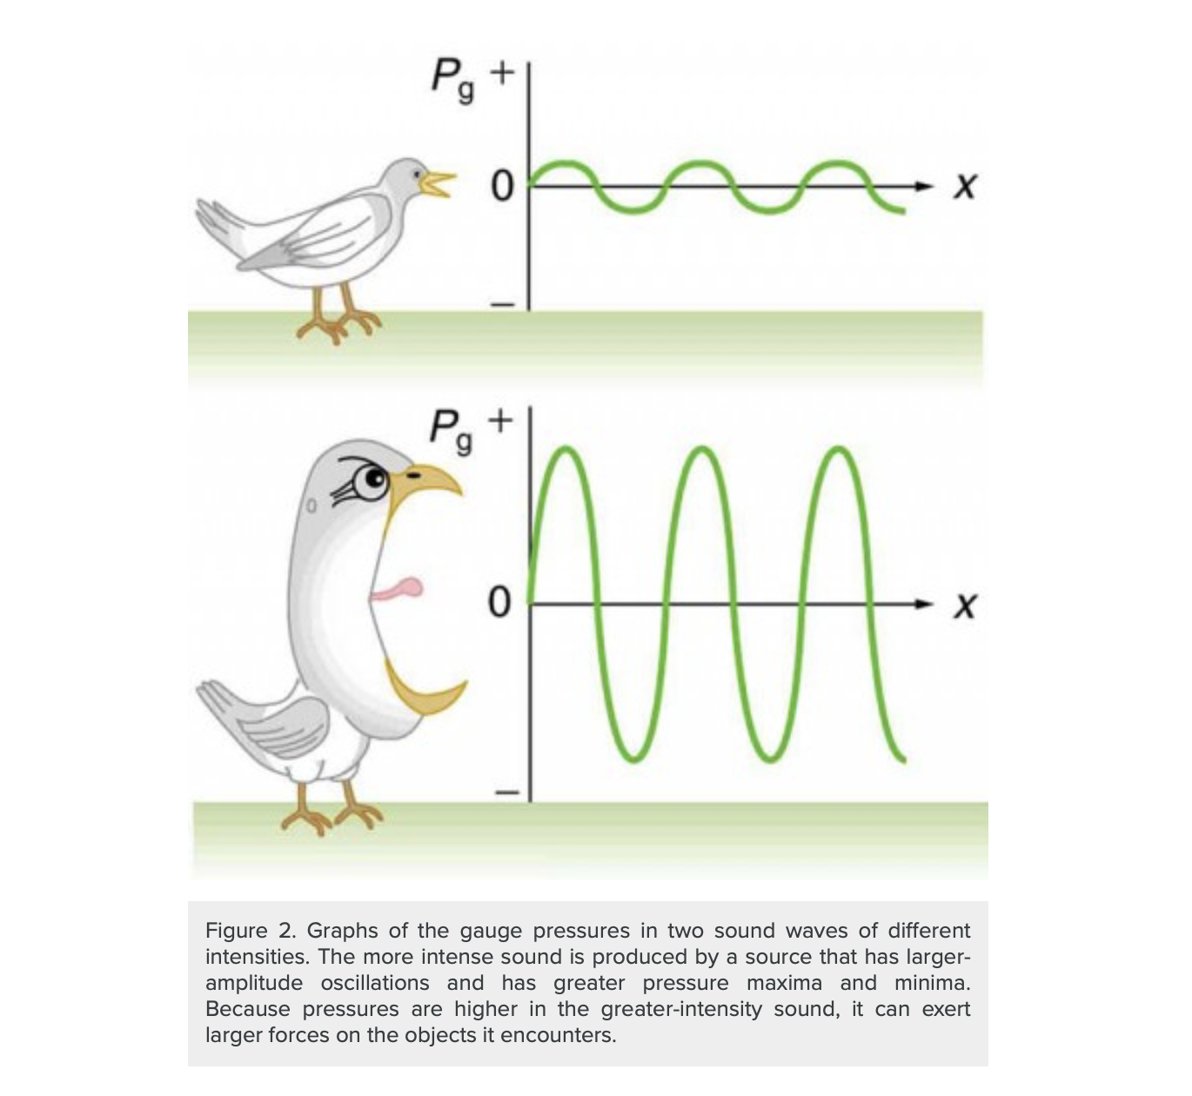
AMPLITUDE (Sound Intensity)
Sound intensity levels are quoted in decibels (dB) much more often than sound intensities in watts per meter squared. Decibels are the unit of choice in the scientific literature as well as in the popular media. The reasons for this choice of units are related to how we perceive sounds. How our ears perceive sound can be more accurately described by the logarithm of the intensity rather than directly to the intensity.
Source: https://courses.lumenlearning.com/physics/chapter/17-3-sound-intensity-and-sound-level/
Notes:
(larger amplitude -> louder)

Slide 7
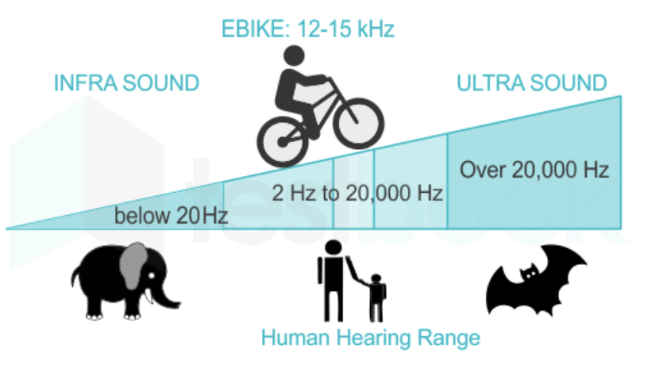
Unit of Frequency
The units of frequency are called hertz (Hz). Humans with normal hearing can hear sounds between 20 Hz and 20,000 Hz. Frequencies above 20,000 Hz are known as ultrasound.
Source: https://selfstudy365.com/qa/the-frequency-range-for-hearing-the-sound-by-a-human-ear-is-in-the-ran-5eee3cb408665507c5926a6c

Slide 8
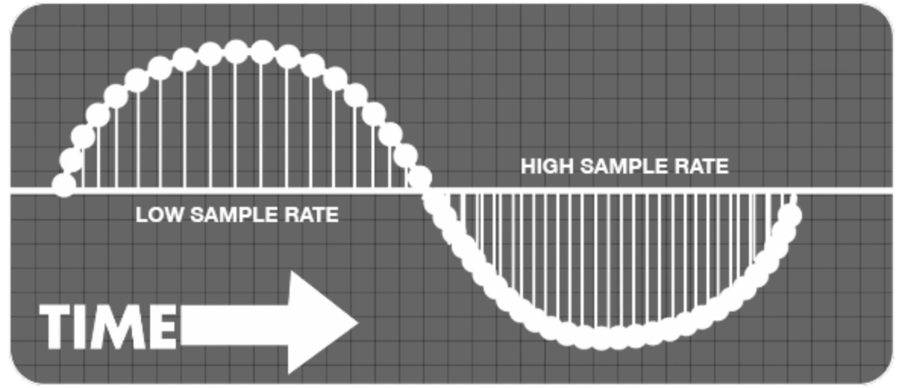
What are sample rates?
https://homestudiorecordings.com/sample-rate-bit-depth/
Notes:
When you’re trying to sample audio from an analogue source, a calculation takes place inside the computer. The calculation converts the analogue sounds of a guitar, keyboard or other instrument into digital data. Sample rate is key to the quality of this conversion.
Audio sampling is the process of transforming a musical source into a digital file. Digital audio recording does this by taking samples of the audio source along the soundwaves at regular intervals. The more samples you take - known as the ‘sample rate’ - the more closely the final digital file will resemble the original. A higher sample rate tends to deliver a better-quality audio reproduction.
https://www.adobe.com/sg/creativecloud/video/discover/audio-sampling.html

Slide 9
02
The Datasets

Slide 10
3 Datasets
RAVDESS
SAVEE
TESS
The Ryerson Audio-Visual Database of Emotional Speech and Song (RAVDESS)
Surrey Audio-Visual Expressed Emotion (SAVEE)Database
Toronto emotional speech set (TESS)
References:
https://zenodo.org/record/1188976#.YmlBpS8RoTs
https://tspace.library.utoronto.ca/handle/1807/24487
http://personal.ee.surrey.ac.uk/Personal/P.Jackson/SAVEE/Database.html

Slide 11








RAVDESS
SAVEE
TESS

Slide 12
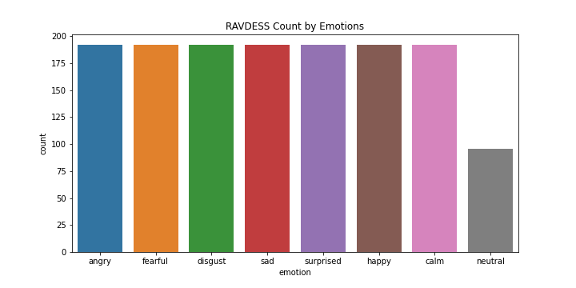
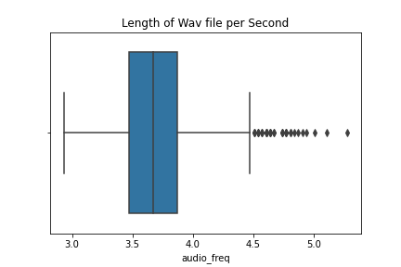
RAVDESS
Sample RATE: 22050 Hz
8 emotions
1440 SAMPLES
AVE:3.5-4 sec

Slide 13
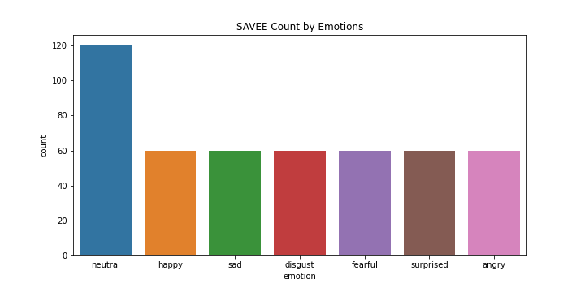
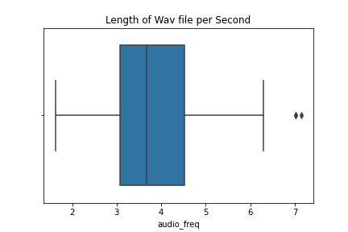
SAVEE
Sample RATE: 22050 Hz
7 emotions
480 SAMPLES
AVE:3-4.5 sec

Slide 14
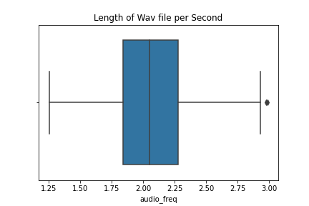
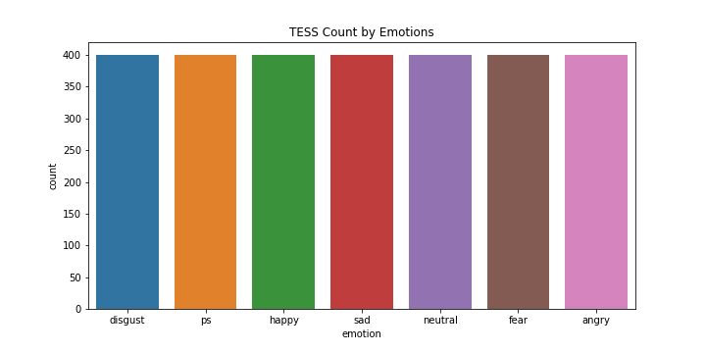
TESS
Sample RATE: 22050 Hz
7 emotions
2800 SAMPLES
AVE:1.8-2.25 sec

Slide 15
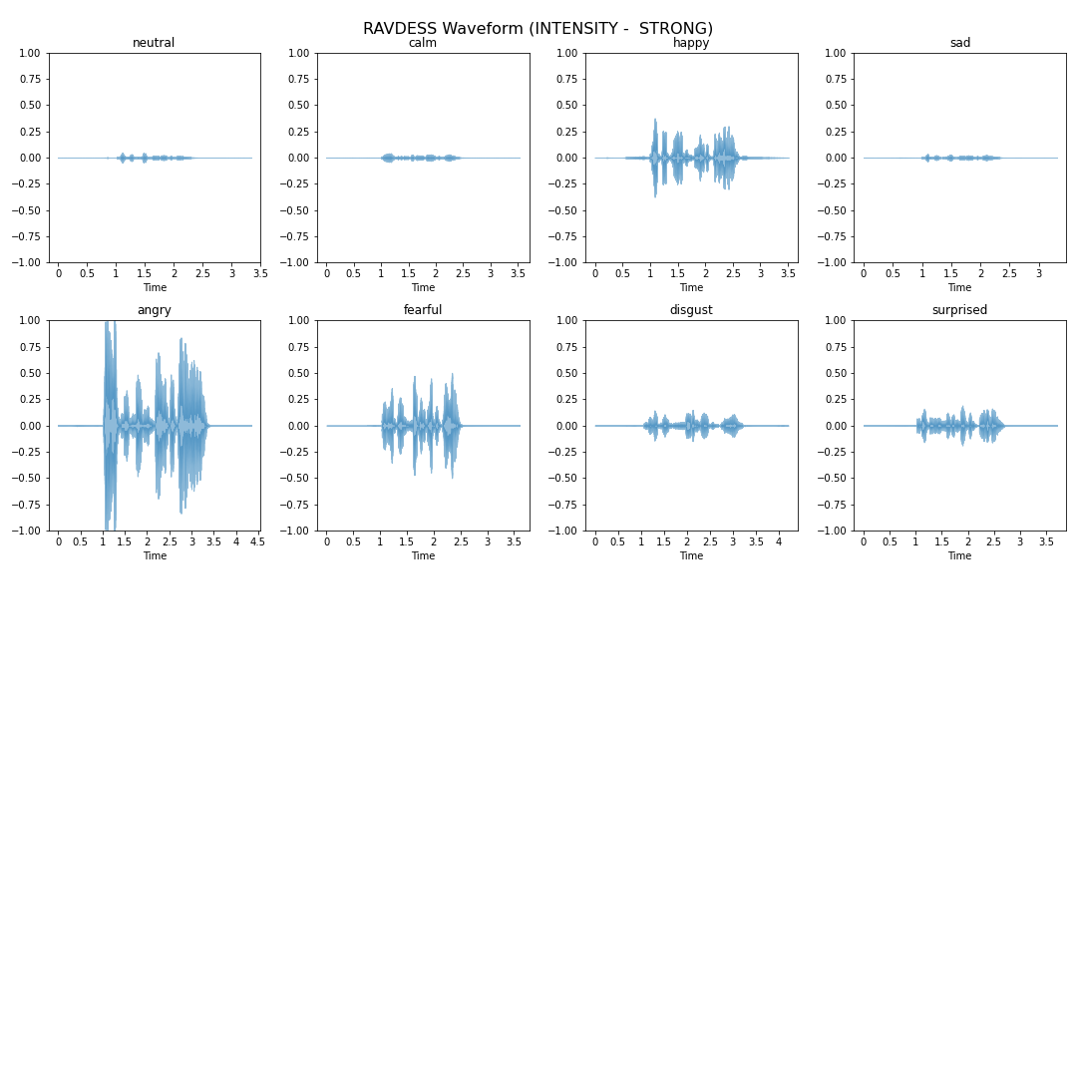
WAVEFORM - RAVDESS

Slide 16
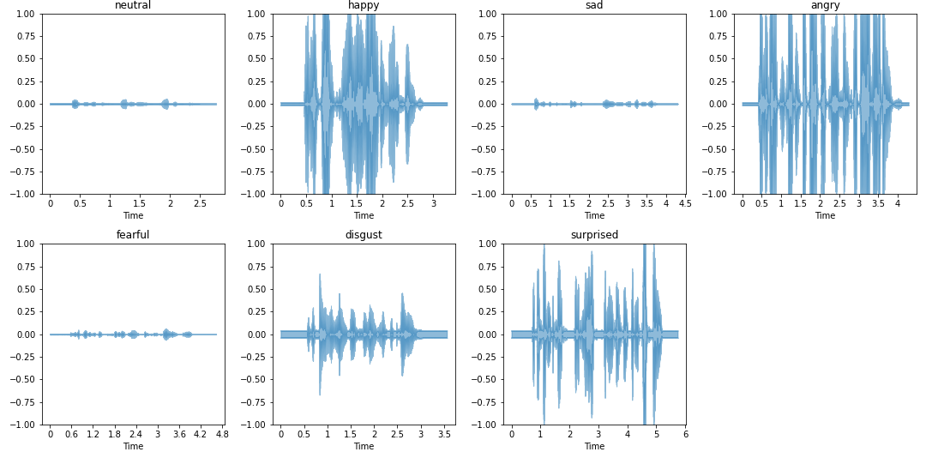
WAVEFORM - SAVEE
Return

Slide 17
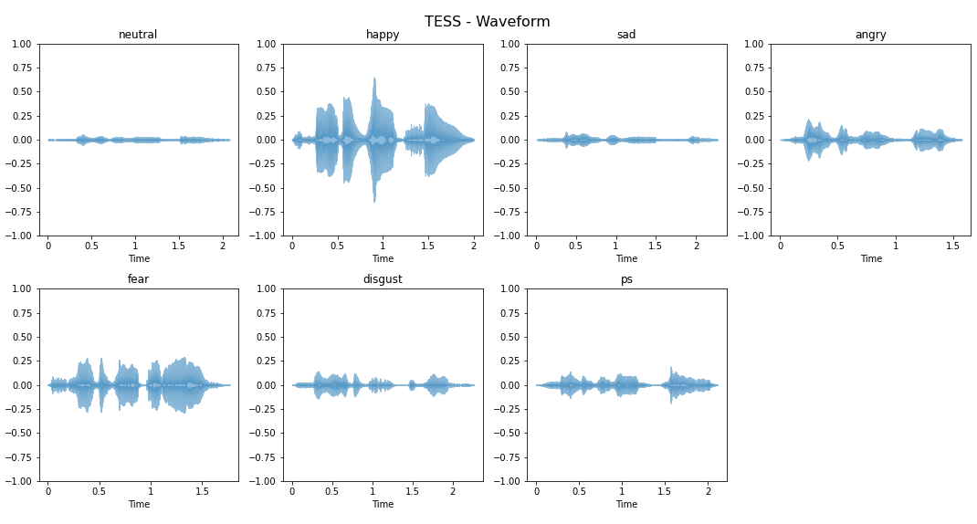
WAVEFORM - TESS
Return

Slide 18

03
Audio features

Slide 19
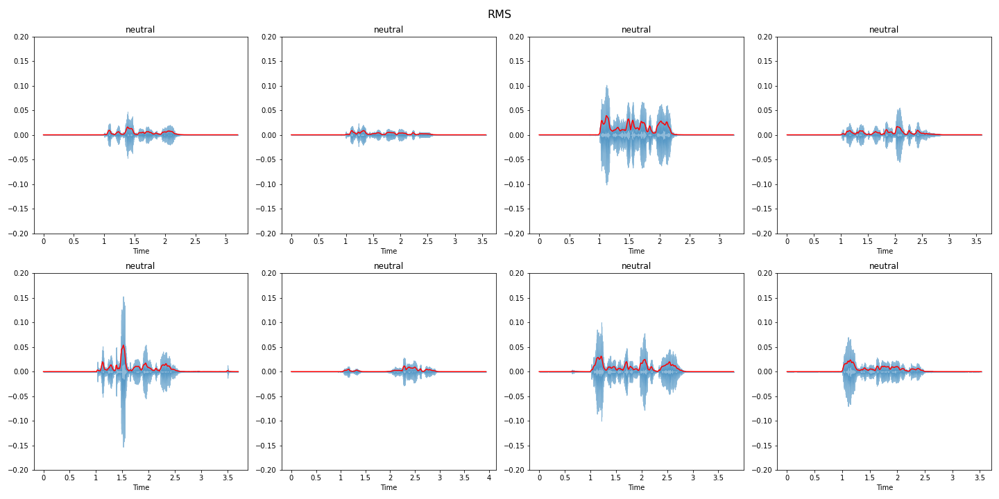
ROOT MEAN SQUARE

Slide 20
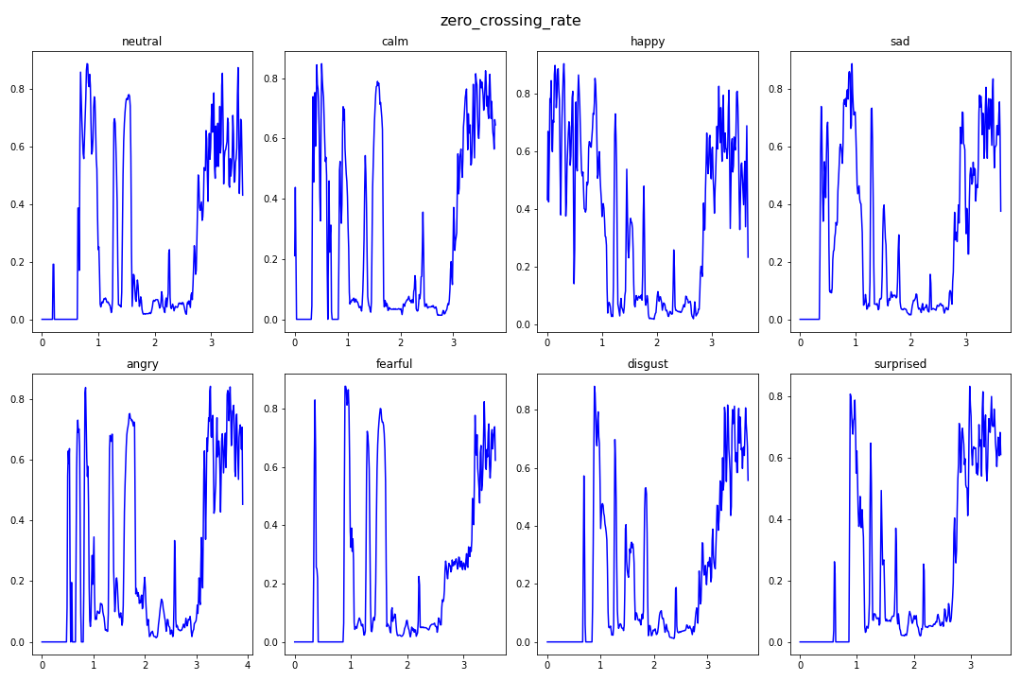
Zero Crossing RATE

Slide 21
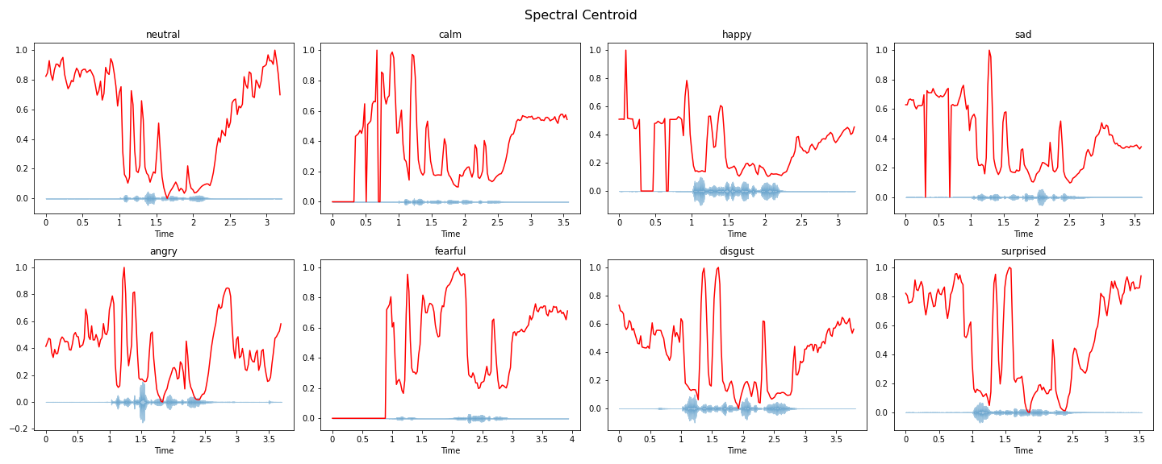
Spectral CENTROID

Slide 22
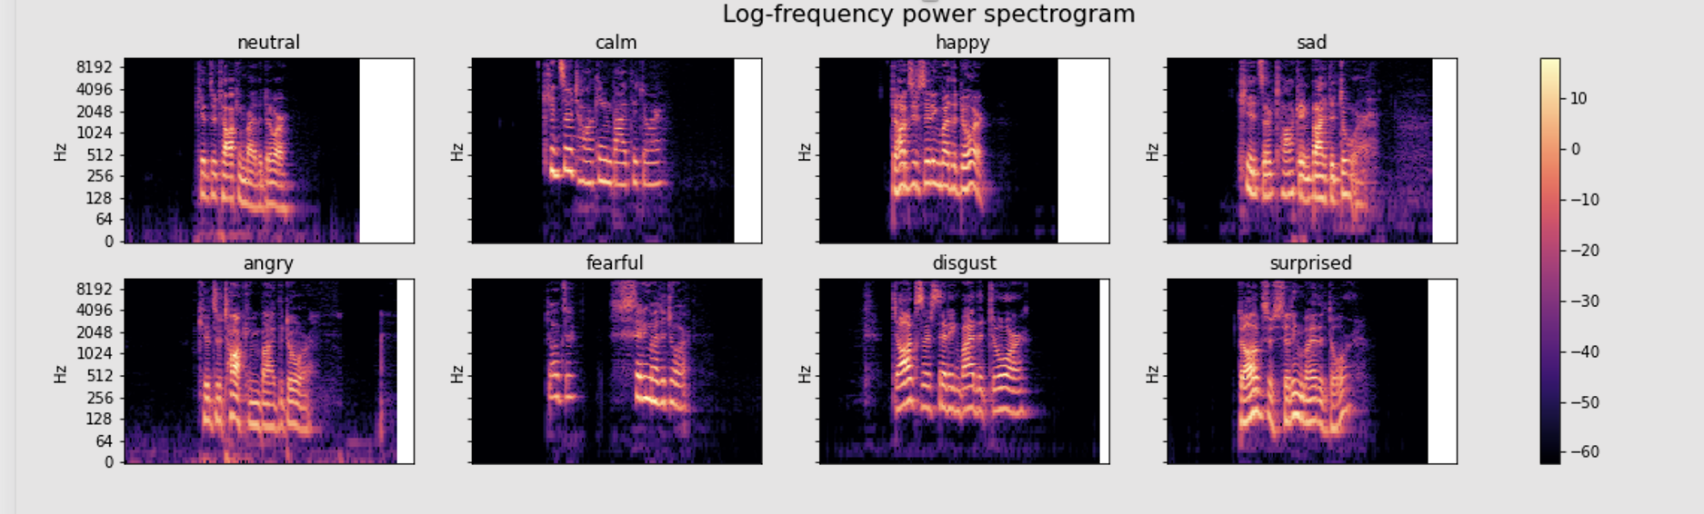
MEL-SPECTOGRAM
Notes:
Spectogram
Mel scale — deals with human perception of frequency, it is a scale of pitches judged by listeners to be equal distance from each other

Slide 23
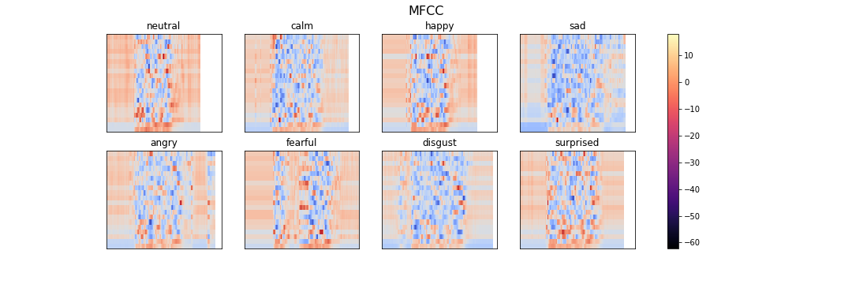
MFCC

Slide 24
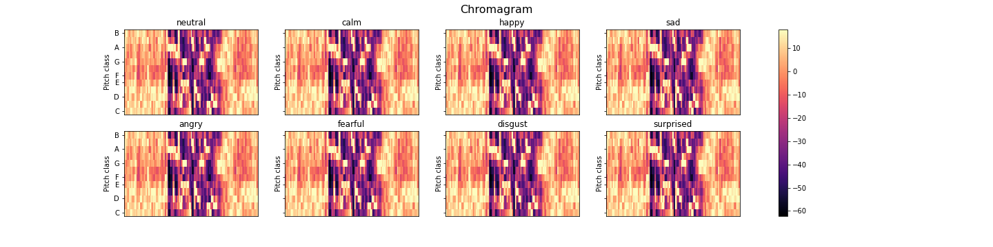
Chroma STFT
Notes:
Chroma — Representation for audio where spectrum is projected onto 12 bins representing the 12 distinct semitones (or chroma). Computed by summing the log frequency magnitude spectrum across octaves.
Fourier Transforms — used to convert from time domain to frequency domain. Time domain shows how signal changes over time. Frequency domainshows how much of the signal lies within each given frequency band over a range of frequencies

Slide 25
DATA AUGMENTATION

Slide 26
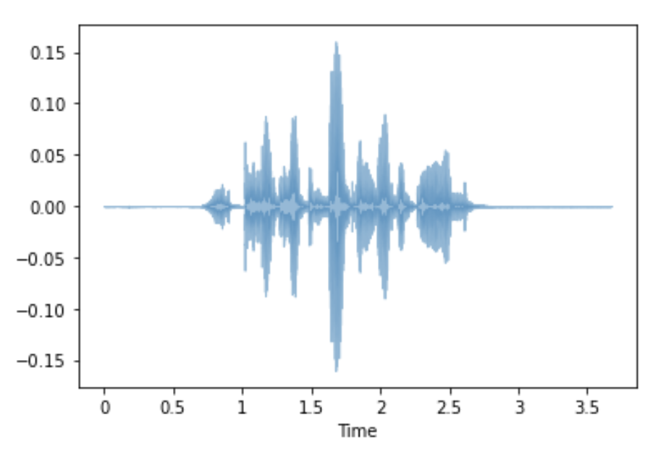
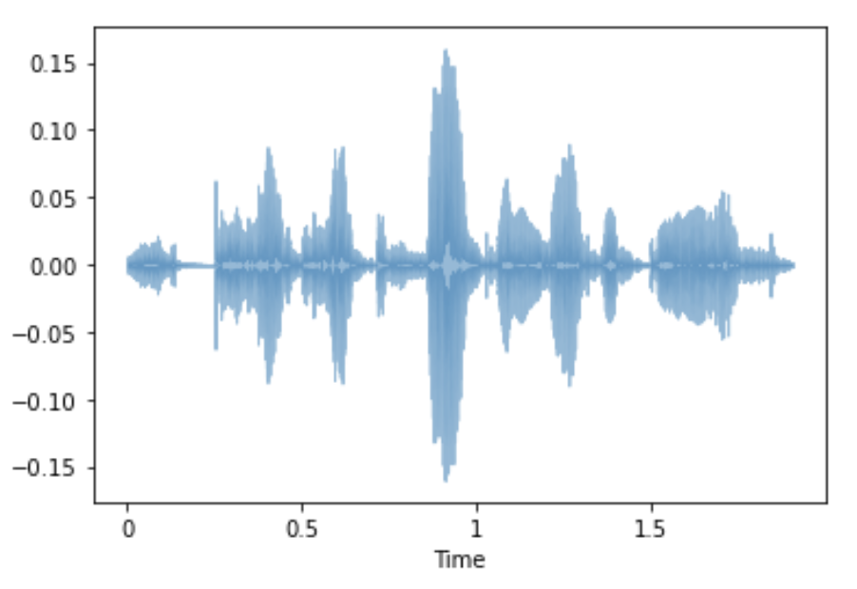
Trimming
TRIM

Slide 27
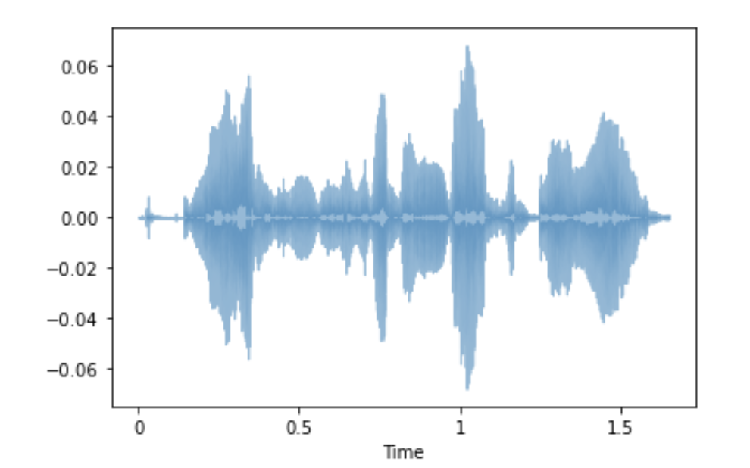
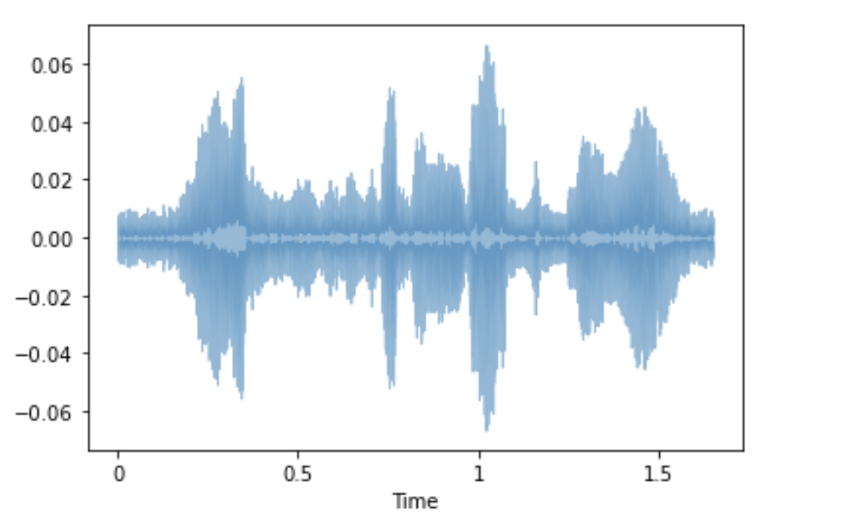
ADDING Noise
Noise

Slide 28
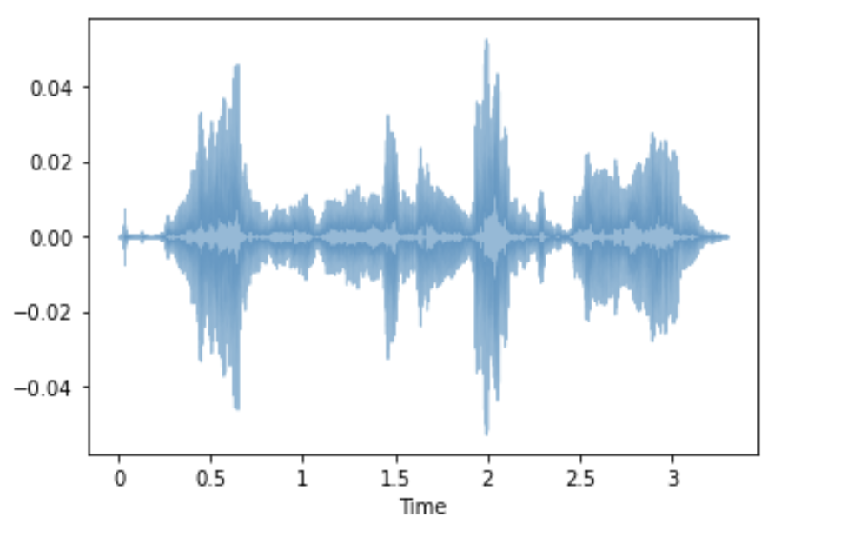
STRETCHING
Stretch

Slide 29
MODEL

Slide 30
184 Features, 7 Target emotions
RMS ZCR Spectral Centroid/ROLLOF
2%
6.5%
21.7%
70%
Chroma STFT
MFCC
MEL SPECTOGRAM

Slide 31
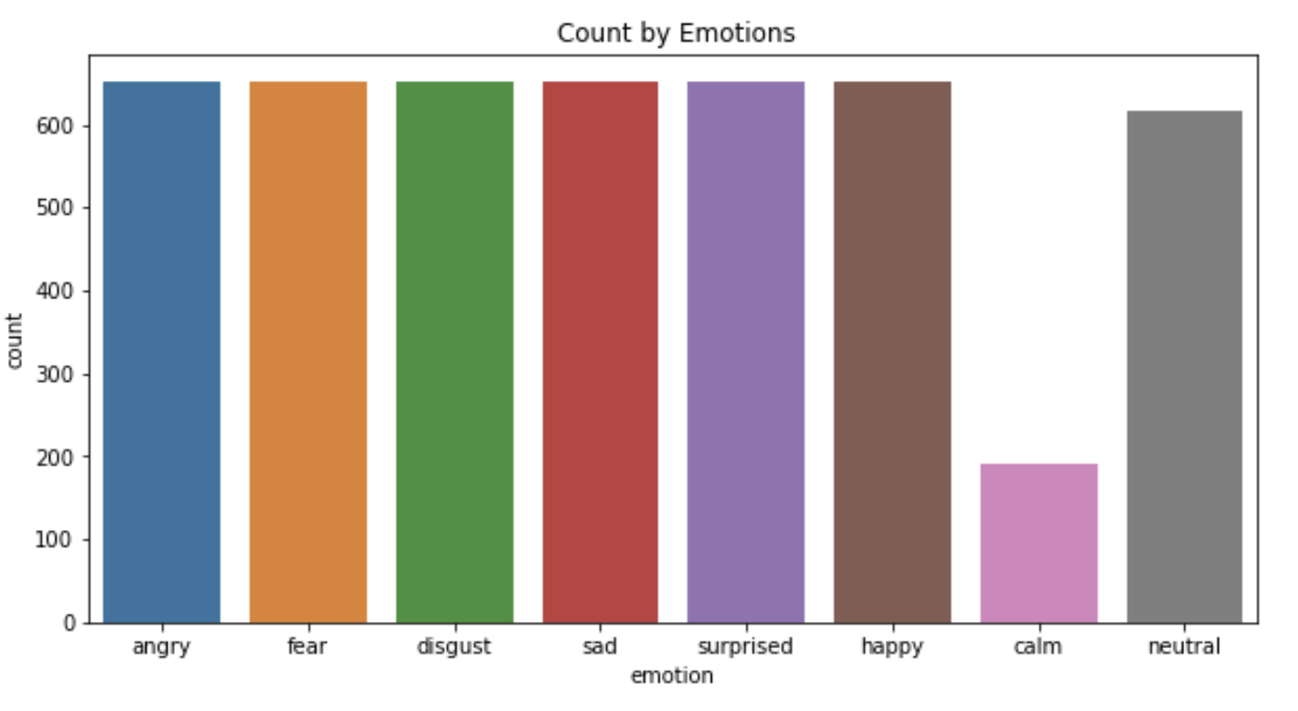
TRAIN TEST SPLIT (4,528 samples)
TRAIN: 75%
Original: 3,396
w/ Noise: 3,396
Change of Pitch: 3,396
Total: 10,188
TEST: 25%
*Excluded Calm
1,132

Slide 32
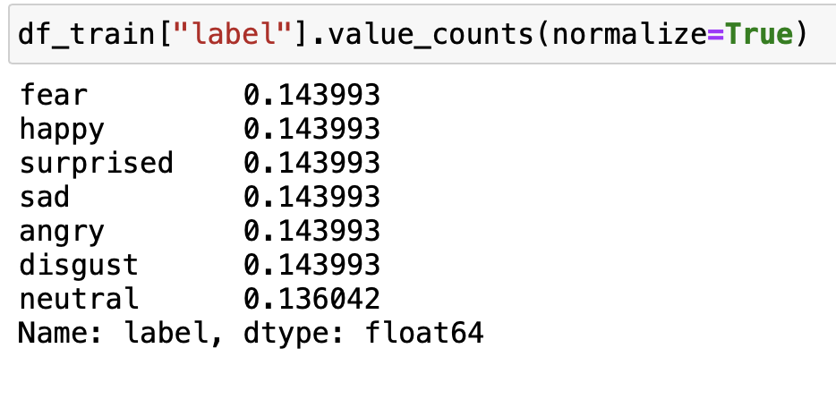
Base MODEL – 14%
Notes:
Optuna is automatic hyperparameter tuning framework
MLPClassifier stands for Multi-layer Perceptron classifier which in the name itself connects to a Neural Network. Unlike other classification algorithms such as Support Vectors or Naive Bayes Classifier, MLPClassifier relies on an underlying Neural Network to perform the task of classificationk that is completely written in Python.

Slide 33
Accuracy
*Random Forest | *MLP Classifier | *Voting Classifier | TensorFlow
83% | 88% | 89% | 86%
*Best Parameters using Optuna
Notes:
Optuna is automatic hyperparameter tuning framework
MLPClassifier stands for Multi-layer Perceptron classifier which in the name itself connects to a Neural Network. Unlike other classification algorithms such as Support Vectors or Naive Bayes Classifier, MLPClassifier relies on an underlying Neural Network to perform the task of classificationk that is completely written in Python.

Slide 34
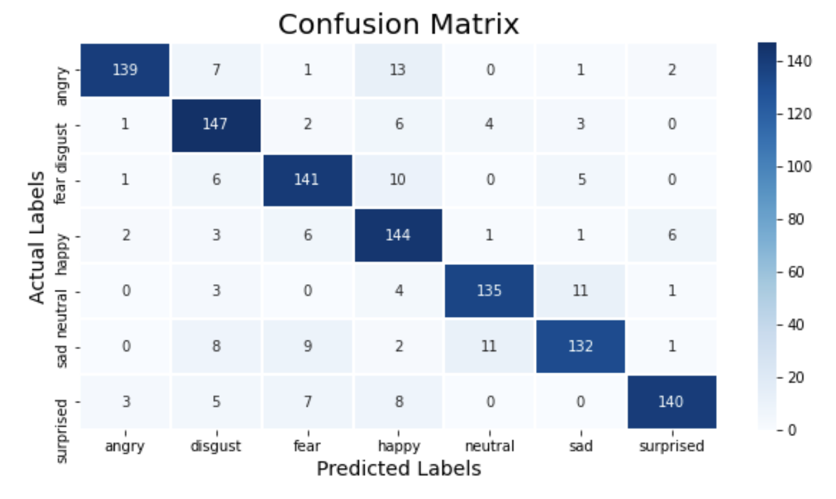
DEEP LEARNING (Conv1D)
 | F1 Score
Angry | 90%
Disgust | 86%
Fear | 86%
Happy | 82%
Neutral | 89%
Sad | 84%
Surprised | 89%
Link to: Sample wave form

Slide 35
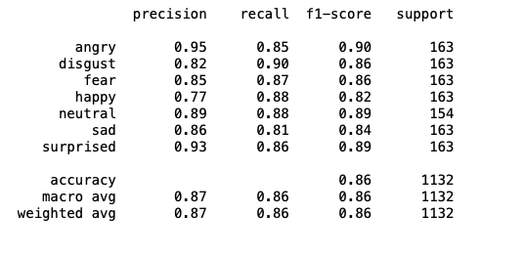
DEEP LEARNING (Conv1D)

Slide 36
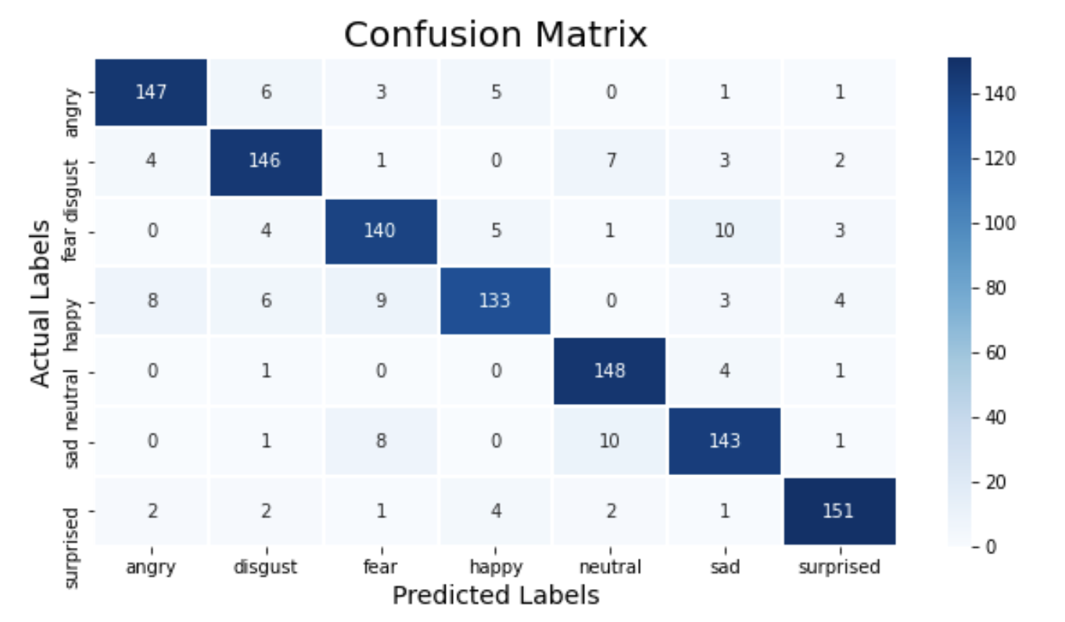
Voting CLASSIFIER (RF+MLP)
 | F1 Score
Angry | 91%
Disgust | 89%
Fear | 86%
Happy | 86%
Neutral | 92%
Sad | 87%
Surprised | 93%
Link to: Sample wave form

Slide 37
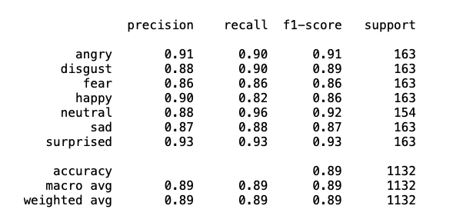
Voting CLASSIFIER (RF+MLP)

Slide 38
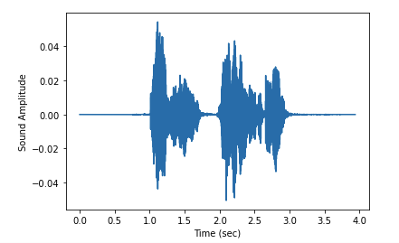
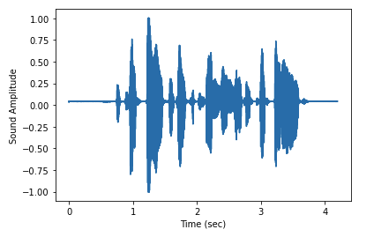
misclassified emotions (VOTINGCLASSIFIER)
Actual is ['sad'] Predicted as ['fear']
Actual is ['fear'] Predicted as ['surprised']

Slide 39
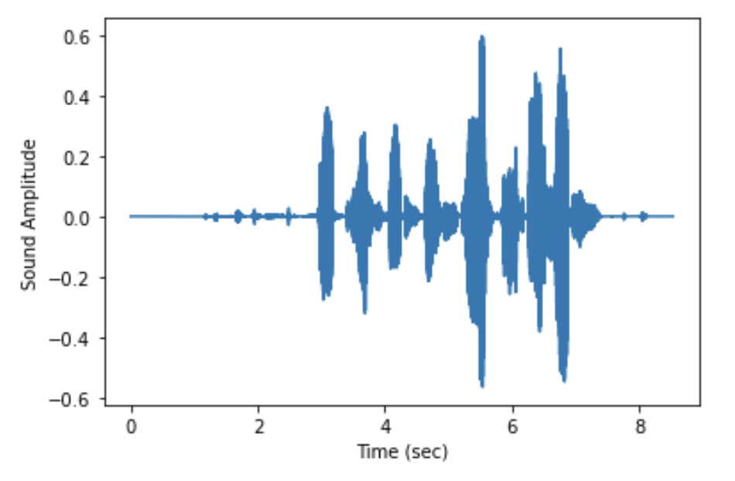
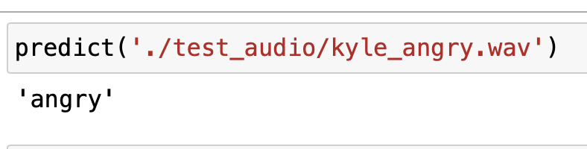
PREDICT from actual recordings

Slide 40
RECOMMENDATIONS
Deep Learning model has a lot of room for improvement, tuning by adding more hidden layers, we can try to achieve 90% accuracy.
For enhancement, this can be a two-step model,
where we identify the gender first, then the emotions.

Slide 41
THANKS!
Do you have any questions?
carinarebellon@outlook.com
+65 9855 1334
Please keep this slide for attribution

Slide 42


